Slide 1
FAIR Data @ CERIC-ERIC
November 4th , 2019
Author: Roberto Pugliese, CERIC-ERIC

Slide 2
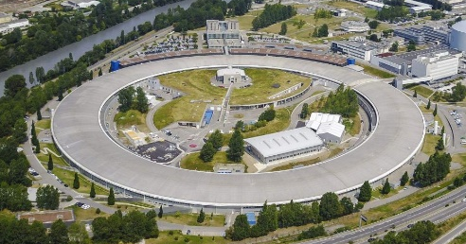
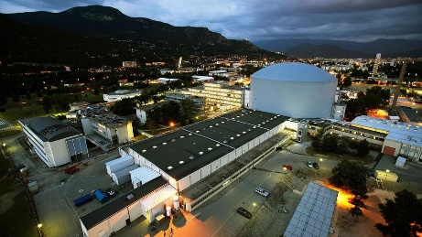
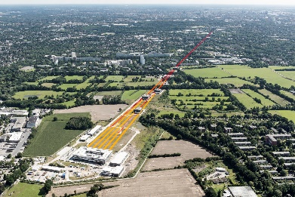




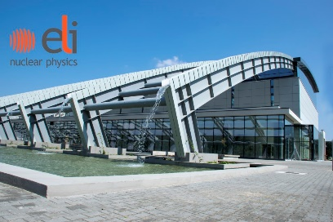



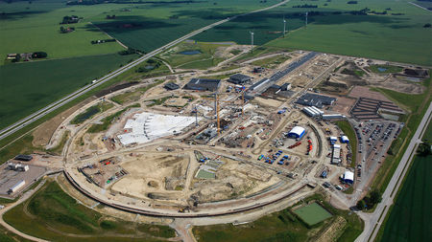
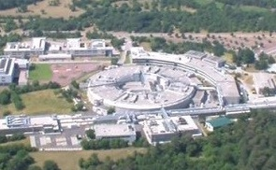



FAIR Data @ CERIC-ERIC = PaNOSC

Slide 3
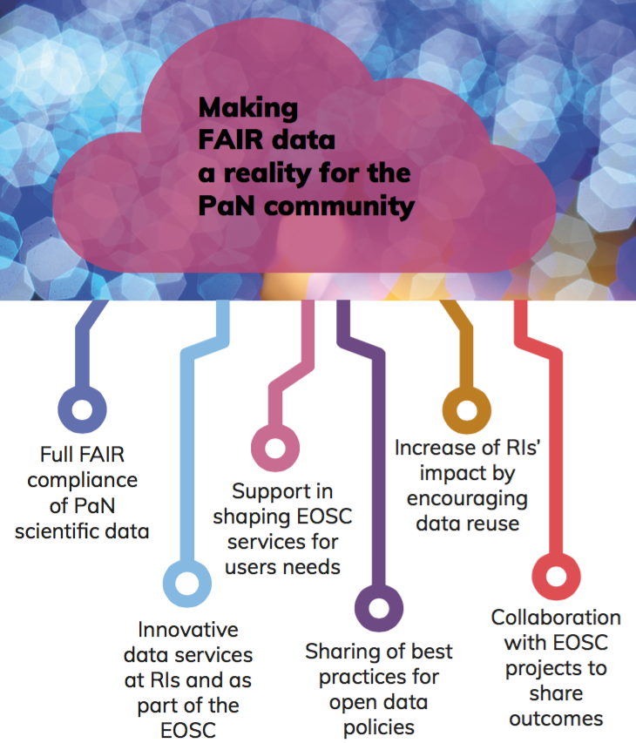

PaNOSC goals

Slide 4
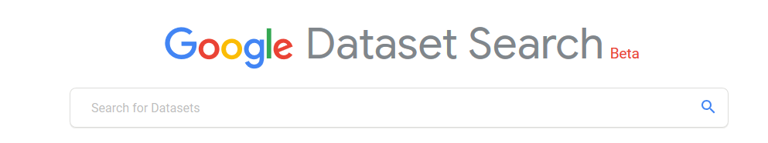

Implementing a common API searchable across sites
Common API to search across all PaNOSC catalogues
ESRF
(icat)
CERIC-ERIC
(VUO/icat)
ESS
(SciCat)
ILL
(local)
ELI
(tbd)
XFEL
(MyMdc)

Slide 5

CERIC–ERIC additional challenges

Slide 6
Who we are?
CERIC is a European Research Infrastructure Consortium (ERIC) integrating and providing open access to some of the best facilities in Europe, to help science and industry advance in all fields of materials, biomaterials and nanotechnology. With a single entry point to some of the leading national research infrastructures in 8 European countries, it enables the delivery of innovative solutions to societal challenges in the fields of energy, health, food, cultural heritage and more.

Slide 7
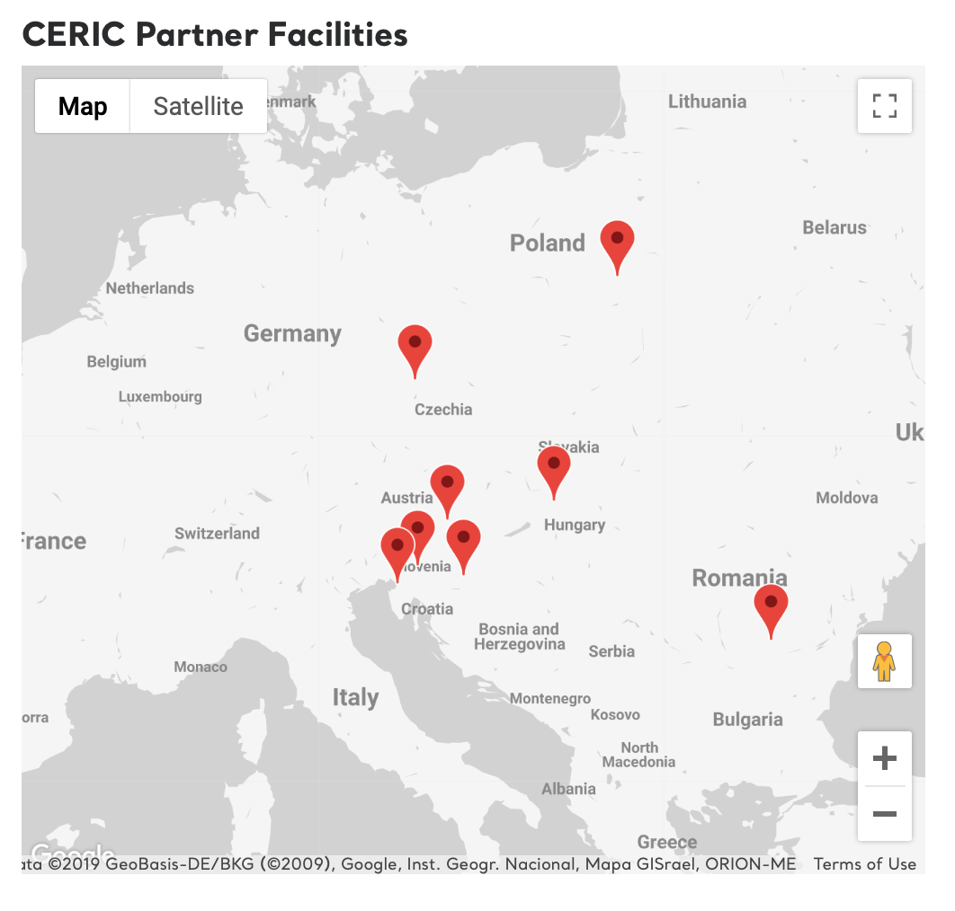
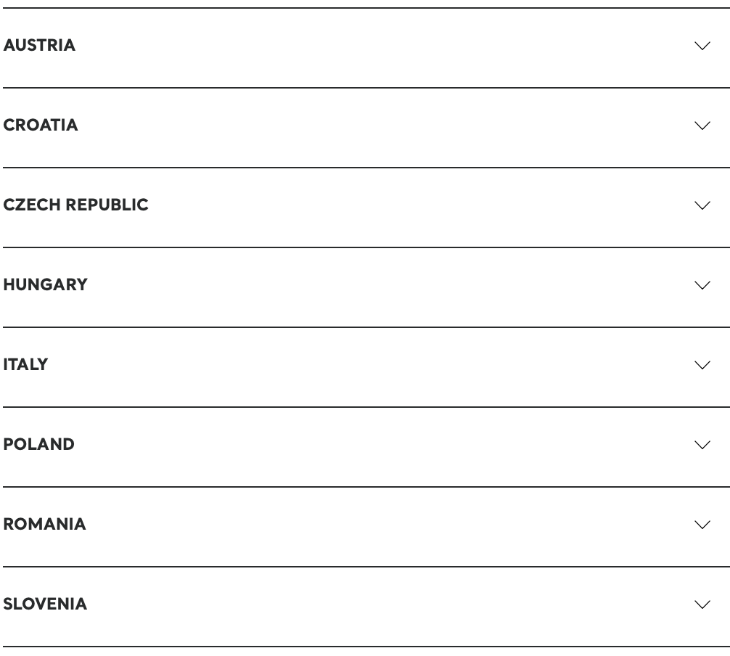
Who we are?

Slide 8
CERIC Facilities
The Austrian facility (RE: Graz University of Technology) is dedicated to the structural characterization of nanosystems with scattering techniques covering topics such as advanced materials, (bio-)polymers, proteins in solids, surfaces, liquids and in the gas phase. The facility provides access to its light and X-ray scattering laboratories, as well as to the Austrian SAXS beamline and Deep X-ray Lithography beamline, both at Elettra.
The Croatian facility (RE: Ruđer Bošković Institute) develops and allows access to ion beam techniques for materials’ modification and characterization, such as PIXE and RBS, as well as a heavy ion microprobe, dual beam irradiation chamber with RBS/channeling, and TOF ERDA spectrometer.

Slide 9
CERIC Facilities
The Czech facility (RE: Charles University Prague) has expertise in surface analysis, thin film growth and studies of the reaction mechanism on catalyst surfaces. It offers Photoelectron Spectroscopy (XPS, XPD, ARUPS) with Low Energy Ion Scattering Spectroscopy and LEED, Field Emission Gun Scanning Electron Microscope, Near Ambient Pressure XPS and access to the Materials Science Beamline at synchrotron Elettra dedicated to soft X-ray photoelectron spectroscopy and NEXAFS.
The Hungarian facility (RE: Hungarian Academy of Sciences – Centre for Energy Research) performs R&D in nuclear science and technology, studying the interaction of radiation with matter and doing isotope and nuclear chemistry, radiography and radiation chemistry, surface chemistry and catalysis (PGAA, NAA, RAD). Neutron scattering instruments allow investigation of microscopic properties of solids, liquids, soft materials, biological objects and condensed matter (PSD, SANS, TOF, GINA, MTEST, BIO, TAST).

Slide 10
CERIC Facilities
The Italian facility (RE: Elettra Sincrotrone Trieste) covers a wide range of experimental techniques and scientific fields, including photoemission, spectromicroscopy, crystallography, dichroic absorption spectroscopy, x-ray imaging etc.
The Polish facility (RE: Polish Ministry of Science and Higher Education) offers techniques based on synchrotron radiation: the PEEM/XAS beamline. The UARPES undulator beamline. Additionally, the SOLARIS Centre makes available state-of-the-art Krios™ G3i Cryo-Transmission Electron Microscope for life science researchers. The microscope enables high-resolution structural analyses of frozen hydrated specimens.

Slide 11
CERIC Facilities
The Romanian facility (RE: National Institute of Material Physics) has HRTEM and EPR laboratories for research in solid state physics and materials science, including the synthesis and characterization of advanced materials for applications in microelectronics, catalysis, energy industry and ICT.
The Slovenian facility (RE: National Institute of Chemistry) offers NMR spectroscopy for chemical analysis and identification, for determining 3D structures and studying the dynamics of small and larger bio-macro-molecules, for tracking chemical reactions in analytical and bioanalytical procedures, for studying polycrystallinity and identifying metabolites and various amorphous forms.

Slide 12
What are the changes in the data policy?
… A copy of the data will be saved in the storage system of the research facility for period ranging from a minimum of 15 days to 10 years. … Access to raw data and the associated metadata is restricted to the experimental team for a period of 3 years after the end of the experiment. … After this period each year the principal investigator will be asked for permission to give open access to the raw data. … in case the permission is given the raw data will become openly accessible.
The New is more precise and operational and users will be asked to accept it before submitting a proposal as already occurs in other facilities (ESRF, ILL, Diamond, …)

Slide 13
The New Scientific Data Policy
Precise definition of terms
3 Years Embargo Period
Up to 2 Years extension upon motivation (approval of the motivation by CSO)
Possibility by the PI to make the data open even before the terms
Keep the data for a minimum of 6 years up to 10 years
Check if publication associated and access request:
if associated publication we keep data forever
If no associated publication and no access request we can drop
Internal research and Private research are out of the policy but in the better data management

Slide 14
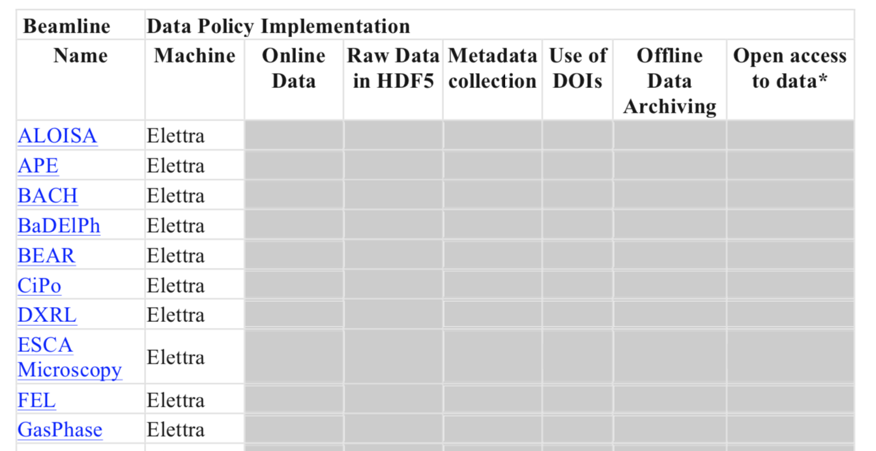
How all this will be implemented?
New web page that describes the new data policy, points to the license and to the new data policy and presents the implementation status on each beamline.
In the VUO when the user submits a proposal have to accept the data policy which is first presented. Submission is prevented if the user doesn’t accepts.

Slide 15
How all this will be implemented?
A new improved storage infrastructure:
Scratch – CEPH Storage
Online – CEPH Storage
Offline – Tape Library
A new improved computing infrastructure
A new VUO virtual laboratory
Elettra 2.0 (170M€ in 10 years)
New beamline control systems and data acquisition systems
HDF Data Format
Data Cite DOIs:
datasets and instruments

Slide 16
Time Between Beamtime and Publication Since 2011

Slide 17
Starting from the beamtime

Slide 18
How can we transform this in a win-win deal?
When there is a request to access the dataset the PI is informed
We suggest the downloader to contact the PI for increased capability to correctly interpret the data
The User/PI can have a chance to increase the number of publications and the opportunity to start new collaborations (i.e. new projects and funding opportunities)

Slide 19
How can we cope with our multidisciplinarity?
Finalize the scientific data policy and have it accepted by the General Assembly
Implement the infrasctructure and test it in CERIC-ERIC beamlines in Elettra (Italy, Austria, Czech Rep.)
Involve asap Solaris (Poland)
Integrate and extend services to the other partners
Iterate, iterate, iterate …

Slide 20
Thank you
roberto.pugliese@elettra.eu

